Slide 1
MultiBoard RoadMap
2023’H1
2023

Slide 2




Prestigio Solutions™
Overview
BELONG TO ASBIS
27 COUNTRIES
ASBISC Enterprises PLC, Cyprus
Of presence across EMEA
9
9 YEARS
< 1%
On the market
Fail rate
FOCUS ON
AV SOLUTIONS
11000+ UNITS
Screens successfully sold already
Focus on Audiovisual Solutions:
HW + SW & Apps + Accessories + Service

Slide 3

Product RoadMap 2023Y
Q1
Q2
Q3
Q4
PMB000L654
No PC
PMB000L754
No PC
PMB000L864
No PC
PMB528K001
PC
PMB528K002
PC with 3G/LTE
PMB728L653
PMB728L753
PMB728L863
PMB751G983

Slide 4
Prestigio Solutions MB LineUp, 2023’H1
65”
PMB000L654 (Light Series)
UHD / Android 8.0 / 20 points multitouch / ARM A73+A53, 3GB, 32GB / PC Windows (optionally)
75”
PMB000L754 (Light Series)
UHD / Android 8.0 / 20 points multitouch / ARM A73+A53, 3GB, 32GB / PC Windows (optionally)
86”
PMB000L864 (Light Series)
UHD / Android 8.0 / 20 points multitouch / ARM A73+A53, 3GB, 32GB / PC Windows (optionally)
65”
PMB528L653 (Prime Series)
UHD, Windows 10 Pro / Android 9.0 / 20 points multitouch / Intel® Core™ i5 10th Gen, 8GB, 256GB / Independent Graphic Card
75”
PMB728L753 (Prime Series)
UHD, Windows 10 Pro / Android 9.0 / 20 points multitouch / Intel® Core™ i7 10th Gen, 8GB, 256GB / Independent Graphic Card
86”
PMB728L863 (Prime Series)
UHD, Windows 10 Pro / Android 9.0 / 20 points multitouch / Intel® Core™ i7 10th Gen, 8GB, 256GB / Independent Graphic Card
98”
PMB751G983 (Prime Series)
UHD, Windows 10 Pro / Android 8.0 / 20 points touch / Intel® Core™ i7 8th Gen, 16GB, 512GB / Independent Graphic Card
PC
PMB528K001 (PC for Light Series models) EOL
PC 80 pin / with Intel® Comet Lake-U CPU i5 10210U 10th Gen / 8GB / 256GB
PC
PMB528K002 (PC for Light Series models)
PC 80 pin / with Intel® Comet Lake-U CPU i5 10210U 10th Gen / 8GB / 256GB, 3G & LTE module

Slide 5
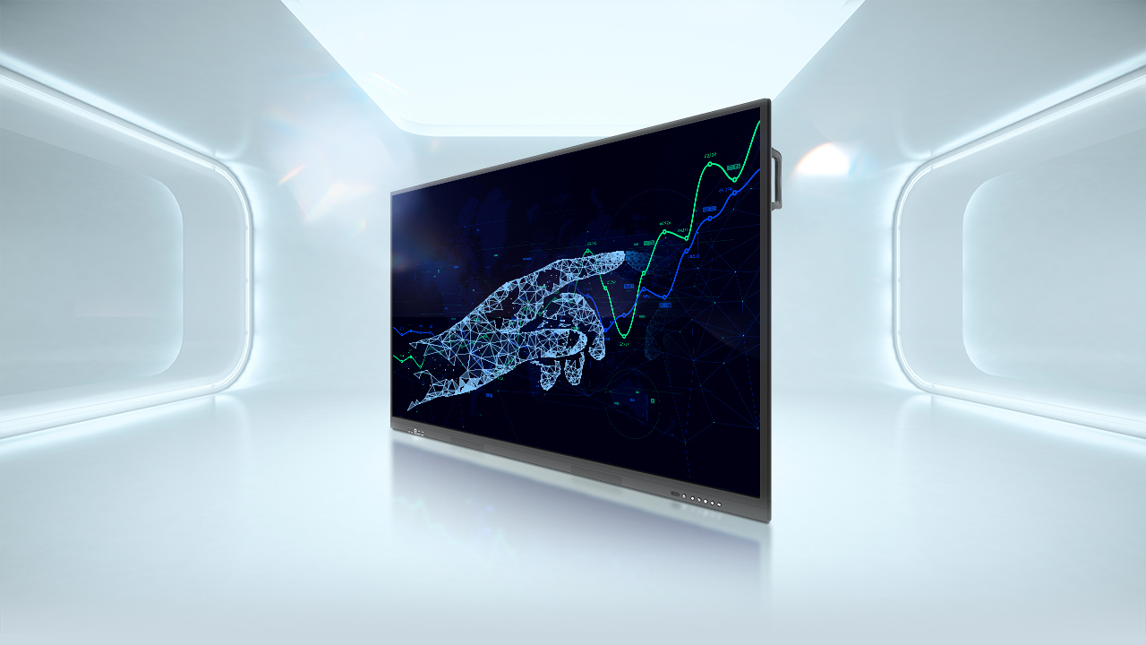

LIGHT SERIES

Slide 6

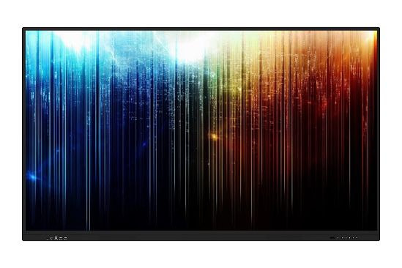
PMB000L654| 65” (Light Series)
DISPLAY | 65‘’ (UHD) / 3840×2160 / IR touch 10 points writing, 20 points touch 3.2mm Toughened Glass
OS | Android 8.0
RESPONSE TIME | 8 ms
BRIGHTNESS / CONTRAST | 400 cd/m2 (orig LCD) / 4000 : 1 (dyn)
REFRESHING FREQUENCY | 60Hz
LIFETIME | 30 000 hours
DISPLAY INTERFACES | HDMI IN x 3 (incl HDMI in front); VGA IN x 1; AV IN x 1; LAN x 2; USB 2.0 x 3 (incl USB in front); USB3.0 x 1 in front (Win PC); Touch port x 2 (incl port in front); USB Type C x 1 (in front); Audio IN x 1; RS232 x 1; HDMI OUT x 1; AV OUT x 1; Audio OUT x 1; Light sensor injected; Injected WiFi 802.11 (a, b, g, n, ac)
ONBOARD | 15W x 2 & subwoofer 15W x 1
EXTRA PC SPECS | ARM Cortex A73 Dual Core + A53 Dual core CPU/ RAM 3GB / ROM 32GB
OVERALL/STANDBY POWER CONSUMPTION | 220W / ≤0.5W
DIMENSIONS / D. (PACK) L*H*W, MM | 1511.6*919.7*87.8 / 1660*245*1045 mm Metal Back cover / VESA 600mm x 400mm (M8 screw)
NET / SHIPPING WEIGHT, KG | est. 41.5 / 57
PREINSTALLED SOFTWARE | App for writing included, App for mirroring included; OfficeSuite2021
IN THE BOX | QSG, AC power cable, remote control, 7 Writing Pens (incl 2 Pens for writing double colors in parallel), USB/HDMI cables, Wall Mount Kit, Warranty Card
RDP / RRP | $1199 / $1499 USD w/o VAT
Production lead time | 3 months
Plus delivery | train – 3 weeks, sea – 6 weeks
One model MOQ | 50 pcs from all subs
Orders based on commitment from all subs

Slide 7
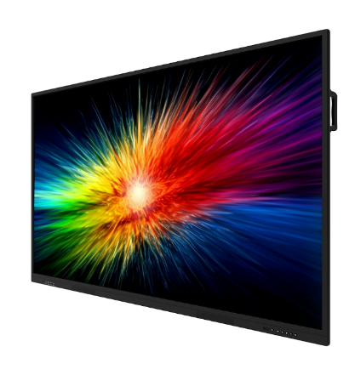
PMB000L754| 75” (Light Series)
DISPLAY | 75‘’ (UHD) / 3840×2160/ IR touch 10 points writing, 20 points touch 3.2mm Toughened Glass
OS | Android 8.0
RESPONSE TIME | 8 ms
BRIGHTNESS / CONTRAST | 400 cd/m2 (orig LCD) / 5000 : 1 (dyn)
REFRESHING FREQUENCY | 60Hz
LIFETIME | 30 000 hours
DISPLAY INTERFACES | HDMI IN x 3 (incl HDMI in front); VGA IN x 1; AV IN x 1; LAN x 2; USB 2.0 x 3 (incl USB in front); USB3.0 x 1 in front (Win PC); Touch port x 2 (incl port in front); USB Type C x 1 (in front); Audio IN x 1; RS232 x 1; HDMI OUT x 1; AV OUT x 1; Audio OUT x 1; Light sensor injected; Injected WiFi 802.11 (a, b, g, n, ac)
ONBOARD | 15W x 2 & subwoofer 15W x 1
EXTRA PC SPECS | ARM Cortex A73 Dual Core + A53 Dual core CPU/ RAM 3GB / ROM 32GB
OVERALL/STANDBY POWER CONSUMPTION | 220W / ≤0.5W
DIMENSIONS / D. (PACK) L*H*W, MM | 1722.5*1033.6*87.1 / 1880*280*1160 mm Metal Back cover / VESA 800mm x 400mm (M8 screw)
NET / SHIPPING WEIGHT, KG | est. 60.5 / 75.6
PREINSTALLED SOFTWARE | App for writing included, App for mirroring included, OfficeSuite2021
IN THE BOX | QSG, AC power cable, remote control, 7 Writing Pens (incl 2 Pens for writing double colors in parallel), USB/HDMI cables, Wall Mount Kit, Warranty Card
RDP / RRP | $1399 / $1699 USD w/o VAT
Production lead time | 3 months
Plus delivery | train – 3 weeks, sea – 6 week
One model MOQ | 50 pcs from all subs
Orders based on commitment from all subs

Slide 8
PMB000L864| 86” (Light Series)
DISPLAY | 86‘’ (UHD) / 3840×2160/ IR touch 10 points writing, 20 points touch 3.2mm Toughened Glass
OS | Android 8.0
RESPONSE TIME | 8 ms
BRIGHTNESS / CONTRAST | 400 cd/m2 / 5000 : 1 (dyn)
REFRESHING FREQUENCY | 60Hz
LIFETIME | 30 000 hours
DISPLAY INTERFACES | HDMI IN x 3 (incl HDMI in front); VGA IN x 1; AV IN x 1; LAN x 2; USB 2.0 x 3 (incl USB in front); USB3.0 x 1 in front (Win PC); Touch port x 2 (incl port in front); USB Type C x 1 (in front); Audio IN x 1; RS232 x 1; HDMI OUT x 1; AV OUT x 1; Audio OUT x 1; Light sensor injected; Injected WiFi 802.11 (a, b, g, n, ac)
ONBOARD | 15W x 2 & subwoofer 15W x 1
EXTRA PC SPECS | ARM Cortex A73 Dual Core + A53 Dual core CPU/ RAM 3GB / ROM 32GB
OVERALL/STANDBY POWER CONSUMPTION | 380W / ≤0.5W
DIMENSIONS / D. (PACK) L*H*W, MM | 1967.9 x 1171.6 x 88.7 mm / 2140 x 1340 x 280 mm Metal Back cover / VESA 800mm x 400mm (M8 screw)
NET / SHIPPING WEIGHT, KG | Est. 78 / 94
PREINSTALLED SOFTWARE | App for writing included, App for mirroring included, OfficeSuite2021
IN THE BOX | QSG, AC power cable, remote control, 7 Writing Pens (incl 2 Pens for writing double colors in parallel), USB/HDMI cables, Wall Mount Kit, Warranty Card
RDP / RRP | $1729 / $2119 USD w/o VAT
Production lead time | 3 months
Plus delivery | train – 3 weeks, sea – 6 week
One model MOQ | 50 pcs from all subs
Orders based on commitment from all subs

Slide 9
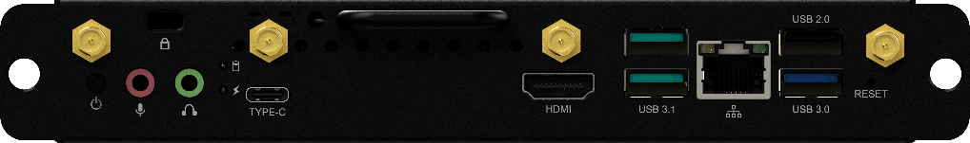
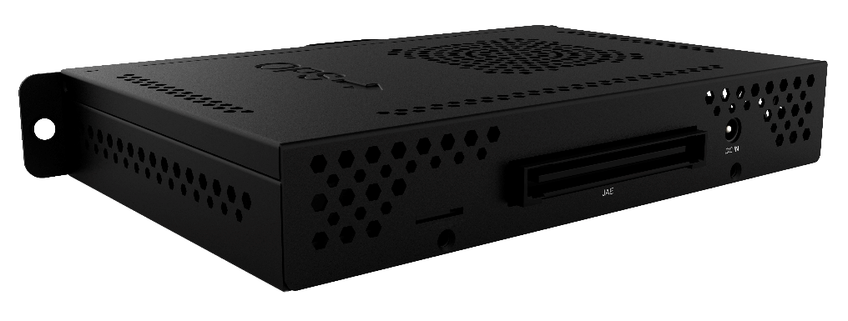
PC Windows for Light Series |
PMB528K002 with 3G & LTE
OS (compatibility) | Windows 10 Pro (trial)
INTERFACES | USB 3.1 x 2; USB 3.0 x 1; USB 2.0 x 1; RJ45 x 1; HDMI OUT x 1; USB 3.1 Type-C; Mic 3.5mm x 1; WiFi 802.11 (ac) 2.4GHz & 5GHz, TPM2.0 support; 2 x 4G/LTE ANT; 1 x SIM Card Slot (Micro SIM)
3G / LTE | 4G: LTE-FDD: B1(2100MHz)/ B3(1800MHz)/ B7(2600MHz)/ B8(900MHz)/ B20(800MHz/ B28(2600MHz) 4G: LTE-TDD: B38(2600MHz)/ B41(2500MHz) 3G: WCDMA: B1/B8 (2100/900MHz)
CPU / RAM / ROM | Intel® Comet Lake-U CPU i5 10210U 10th Gen ; RAM 8GB; SSD 256GB;
GRAPHIC | Intel® HD Graphics 6 series
EXTRA PC SPECS | 80 pin connector;
OVERALL/STANDBY POWER CONSUMPTION | 60W / ≤0.83W
DIMENSIONS / D. (PACK) L*H*W, MM | 119 x 30 x 180 mm / 408 x 402 x 274 mm
NET / SHIPPING WEIGHT, KG | 0.7 / 0.8
PREINSTALLED SOFTWARE | Mozabook Classroom, mClass, OfficeSuite
RDP / RRP | $689 / $849 USD w/o VAT
Production lead time | 3 months
Plus delivery | train – 3 weeks, sea – 6 week
One model MOQ | 50 pcs from all subs
Orders based on commitment from all subs

Slide 10
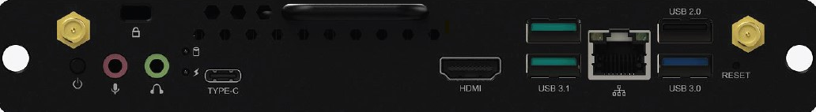
PC Windows for Light Series
| PMB528K001 (EOL)
OS (compatibility) | Windows 10 Pro (trial)
INTERFACES | USB 3.1 x 2; USB 3.0 x 1; USB 2.0 x 1; RJ45 x 1; HDMI OUT x 1; USB 3.1 Type-C; Mic 3.5mm x 1; WiFi 802.11 (ac) 2.4GHz & 5GHz, TPM2.0 support
CPU / RAM / ROM | Intel® Comet Lake-U CPU i5 10210U 10th Gen ; RAM 8GB; SSD 256GB;
GRAPHIC | Intel® HD Graphics 6 series
EXTRA PC SPECS | 80 pin connector;
OVERALL/STANDBY POWER CONSUMPTION | 60W / ≤0.83W
DIMENSIONS / D. (PACK) L*H*W, MM | 119 x 30 x 180 mm / TBC
NET / SHIPPING WEIGHT, KG | 0.7 / 0.8
PREINSTALLED SOFTWARE | Mozabook Classroom, mClass, OfficeSuite
RDP / RRP | $649 / $759 USD w/o VAT

Slide 11

PRIME SERIES

Slide 12

PMB528L653| 65” (Prime Series)
DISPLAY | 65‘’ (UHD) / 3840×2160 / 3mm tempered glass, IR touch 10 points writing, 20 points touch
OS | Windows 10 Pro (official license injected)
RESPONSE TIME | 8 ms
BRIGHTNESS / CONTRAST | 400 cd/m2 (orig LCD) / 3700:1 (dyn)
REFRESHING FREQUENCY | 60Hz
LIFETIME | 30 000 hours
DISPLAY INTERFACES | HDMI IN x 3; USB 2.0 x 1; USB 3.0 x 4 (incl 2 in front); USB Type C x 1; Touch Port x 2; VGA IN x 1; AUDIO IN x 1; AUDIO OUT x 1; RS232 x 1; RJ45 IN x 1; RJ45 OUT x 1; Integrated Light Sensor
WINDOWS PC | Intel® Core™ i5 (10th gen CPU 10500, 3.1GHz) / 8GB DDR4 / 256GB SSD
GRAPHIC CARD | Independent Graphic Card GTX1050Ti
ONBOARD | 16W x 2
PC INTERFACES | USB 3.1 x 1; USB 3.0 x 4; USB 2.0 x 2; MIC x 1; RJ45 x 1; HDMI OUT x 1; DP OUT x 1; WiFi (2.4 & 5 GHz); Kensington Lock x 1; AUDIO OUT x 1;
EXTRA PC TYPE / OS | Android 9.0 (limited)
EXTRA PC SPECS | CPU ARM Cortex A73 x 4 / RAM 4GB / ROM 32GB
OVERALL/STANDBY POWER CONSUMPTION | 450W / ≤0.5W
DIMENSIONS / D. (PACK) L*H*W, MM | 1488*897*86 / 1628*208*1005 mm Metal Back cover
NET / SHIPPING WEIGHT, KG | est. 38 / 48.5
PREINSTALLED SOFTWARE | Apps for education, conference and meetings
IN THE BOX | QSG, AC power cable, remote control, 6 Writing Pens (incl 2 Pens for writing double colors in parallel) & One Multi Pen, USB Touch/HDMI cables, USB-driver stick, Warranty Card
RDP / RRP | $2839 / $3499 USD w/o VAT
Production lead time | 3 months
Plus delivery | train – 3 weeks, sea – 6 weeks
One model MOQ | 50 pcs from all subs
Orders based on commitment from all subs

Slide 13
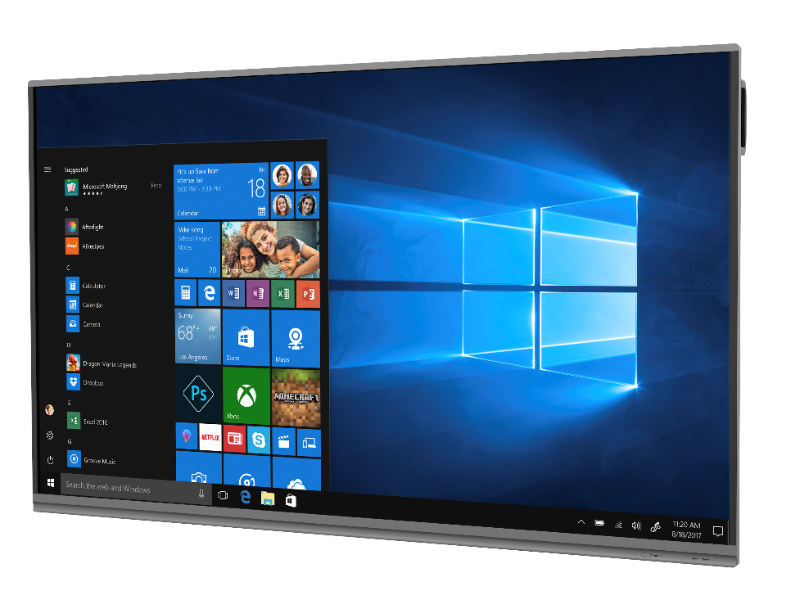

PMB728L753| 75” (Prime Series)
DISPLAY | 75‘’ (UHD) / 3840×2160 / 3mm tempered glass IR touch 10 points writing, 20 points touch
OS | Windows 10 Pro (official license injected)
RESPONSE TIME | 8 ms
BRIGHTNESS / CONTRAST | 390 cd/m2 (orig LCD) / 3100:1
REFRESHING FREQUENCY | 60Hz
LIFETIME | 30 000 hours
DISPLAY INTERFACES | HDMI IN x 3; USB 2.0 x 1; USB 3.0 x 4 (incl 2 in front); USB Type C x 1; Touch Port x 2; VGA IN x 1; AUDIO IN x 1; AUDIO OUT x 1; RS232 x 1; RJ45 IN x 1; RJ45 OUT x 1; Integrated Light Sensor
WINDOWS PC | Intel® Core™ i7 (10th gen CPU 10700, 2.9GHz) / 8GB DDR4 / 256GB SSD
GRAPHIC CARD | Independent Graphic Card GTX1050Ti
ONBOARD | 16W x 2
PC INTERFACES | USB 3.1 x 1; USB 3.0 x 4; USB 2.0 x 2; MIC x 1; RJ45 x 1; HDMI OUT x 1; DP OUT x 1; WiFi (2.4 & 5 GHz); Kensington Lock x 1; AUDIO OUT x 1;
EXTRA PC TYPE / OS | Android 9.0 (limited)
EXTRA PC SPECS | CPU ARM Cortex A73 x 4 / RAM 4GB / ROM 32GB
OVERALL/STANDBY POWER CONSUMPTION | 550W / ≤0.5W
DIMENSIONS / D. (PACK) L*H*W, MM | 1709*1019.5*85.7 / 1860*280*1140 mm Metal Back cover
NET / SHIPPING WEIGHT, KG | est. 49.5 / 63.9
PREINSTALLED SOFTWARE | Apps for education, conference and meetings
IN THE BOX | QSG, AC power cable, remote control, 6 Writing Pens (incl 2 Pens for writing double colors in parallel) & One Multi Pen, USB Touch/HDMI cables, USB-driver stick, Warranty Card
RDP / RRP | $3799 / $4699 USD w/o VAT
Production lead time | 3 months
Plus delivery | train – 3 weeks, sea – 6 weeks
One model MOQ | 50 pcs from all subs
Orders based on commitment from all subs

Slide 14
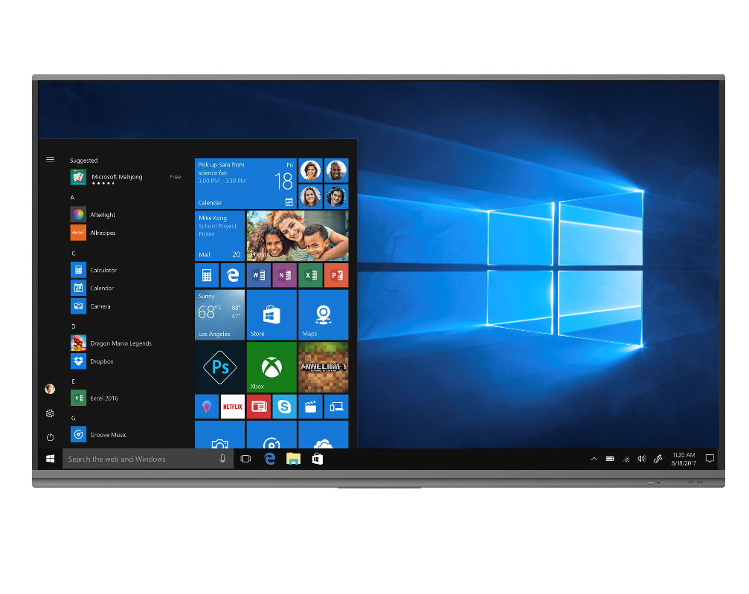
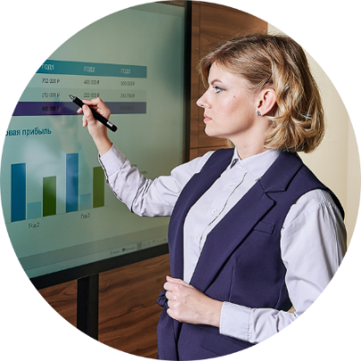
PMB728L863| 86” (Prime Series)
DISPLAY | 86‘’ (UHD) / 3840×2160 / 3mm tempered glass IR touch 10 points writing, 20 points touch
OS | Windows 10 Pro (official license injected)
RESPONSE TIME | 8 ms
BRIGHTNESS / CONTRAST | 350 cd/m2 (LCD orig) / 5300:1 (dyn)
REFRESHING FREQUENCY | 60Hz
LIFETIME | 30 000 hours
DISPLAY INTERFACES | HDMI IN x 3; USB 2.0 x 1; USB 3.0 x 4 (incl 2 in front); USB Type C x 1; Touch Port x 2; VGA IN x 1; AUDIO IN x 1; AUDIO OUT x 1; RS232 x 1; RJ45 IN x 1; RJ45 OUT x 1; Integrated Light Sensor
WINDOWS PC | Intel® Core™ i7 (10th gen CPU 10700, 2.9GHz) / 8GB DDR4 / 256GB SSD
GRAPHIC CARD | Independent Graphic Card GTX1050Ti
ONBOARD | 16W x 2
PC INTERFACES | USB 3.1 x 1; USB 3.0 x 4; USB 2.0 x 2; MIC x 1; RJ45 x 1; HDMI OUT x 1; DP OUT x 1; WiFi (2.4 & 5 GHz); Kensington Lock x 1; AUDIO OUT x 1;
EXTRA PC TYPE / OS | Android 9.0 (limited)
EXTRA PC SPECS | CPU ARM Cortex A73 x 4 / RAM 4GB / ROM 32GB
OVERALL/STANDBY POWER CONSUMPTION | 650W / ≤0.5W
DIMENSIONS / D. (PACK) L*H*W, MM | 1957*1159*86 / 2146*280*1308 mm Metal Back cover
NET / SHIPPING WEIGHT, KG | est. 65 / 83
PREINSTALLED SOFTWARE | Apps for education, conference and meetings
IN THE BOX | QSG, AC power cable, remote control, 6 Writing Pens (incl 2 Pens for writing double colors in parallel) & One Multi Pen, USB Touch/HDMI cables, USB-driver stick, Warranty Card
RDP / RRP | $4290 / $5299 USD w/o VAT
Production lead time | 3 months
Plus delivery | train – 3 weeks, sea – 6 weeks
One model MOQ | 50 pcs from all subs
Orders based on commitment from all subs

Slide 15
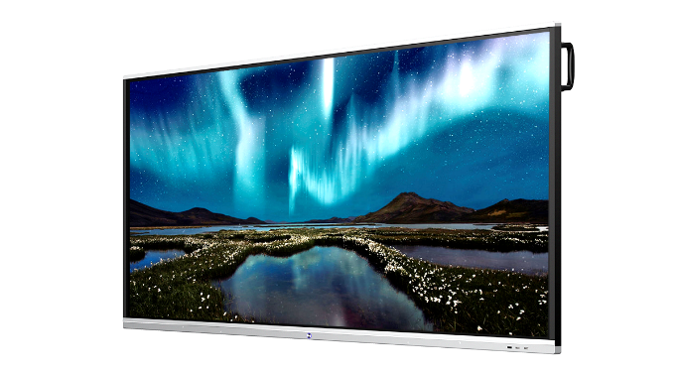
PMB751G983| 98” (Prime Series)
DISPLAY | 98‘’ (UHD) / 3840×2160/ IR touch 10 points writing, 20 points touch
OS | Windows 10 Pro (official license injected)
RESPONSE TIME | 8 ms
BRIGHTNESS / CONTRAST | 350 cd/m2 (typ)/ 1200:1
REFRESHING FREQUENCY | 120Hz
LIFETIME | 30 000 hours
DISPLAY INTERFACES | HDMI IN x 3; HDMI OUT x 1; USB2.0 x 3 (incl 2 ports in front); USB3.0 x 3; Touch x 2; VGA IN x 1; AUDIO IN x 1; AUDIO OUT x 1; LAN x 1; RS232 x 1;
WINDOWS PC | Intel® Core™ i7 (8th gen 8700) / 16GB DDR4 / 512GB SSD
GRAPHIC CARD | Independent Graphics Card
SPEAKERS | 12W x 2
PC INTERFACES | USB 2.0 x 2; USB 3.0 x 4; USB 3.1 Type–C x 1; WiFi 802.11ac (2.4GHz/5GHz), BT4.2; LAN x 1; VGA Out x 1; DP out x 1; Mic In x 1; HDMI Out x 1;
EXTRA PC TYPE / OS | Android 8.0 (Limited)
EXTRA PC SPECS | ARM Cortex A73 Dual Core + A53 Dual core CPU/ RAM 3GB / ROM 16GB
OVERALL/STANDBY POWER CONSUMPTION | 600W / ≤0.5W
DIMENSIONS / D. (PACK) L*H*W, MM | 2244*1323*90.5 / 2483*376*1493
NET / SHIPPING WEIGHT, KG | est 101.5 / 139
PREINSTALLED SOFTWARE | Apps for education, conference and meetings (see slide 18-21)
IN THE BOX | QSG, AC power cable, remote control, 6 Writing Pens (incl 2 Pens for writing double colors in parallel) & One Multi Pen, audio/USB/VGA/HDMI cables, USB-driver stick, Wi-Fi antenna x 2, Warranty Card
RDP / RRP | $8589 / $9999USD w/o VAT
Production lead time | 3 months
Plus delivery | train – 3 weeks, sea – 6 week
One model MOQ | 5 pcs from all subs
Orders based on commitment from all subs

Slide 16

ACCESSORIES

Slide 17
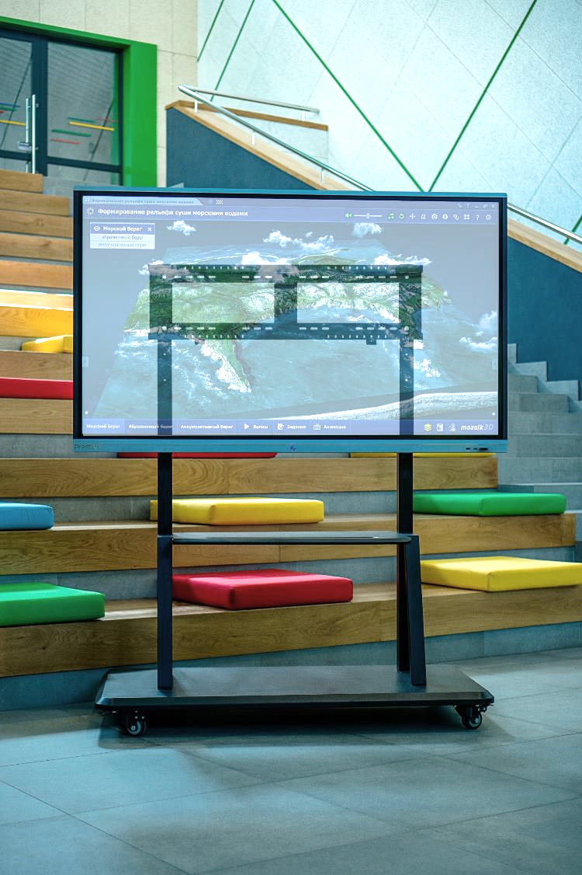
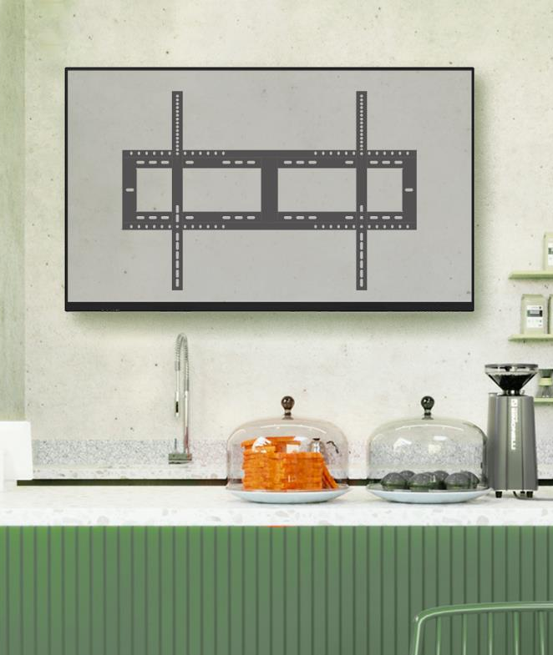
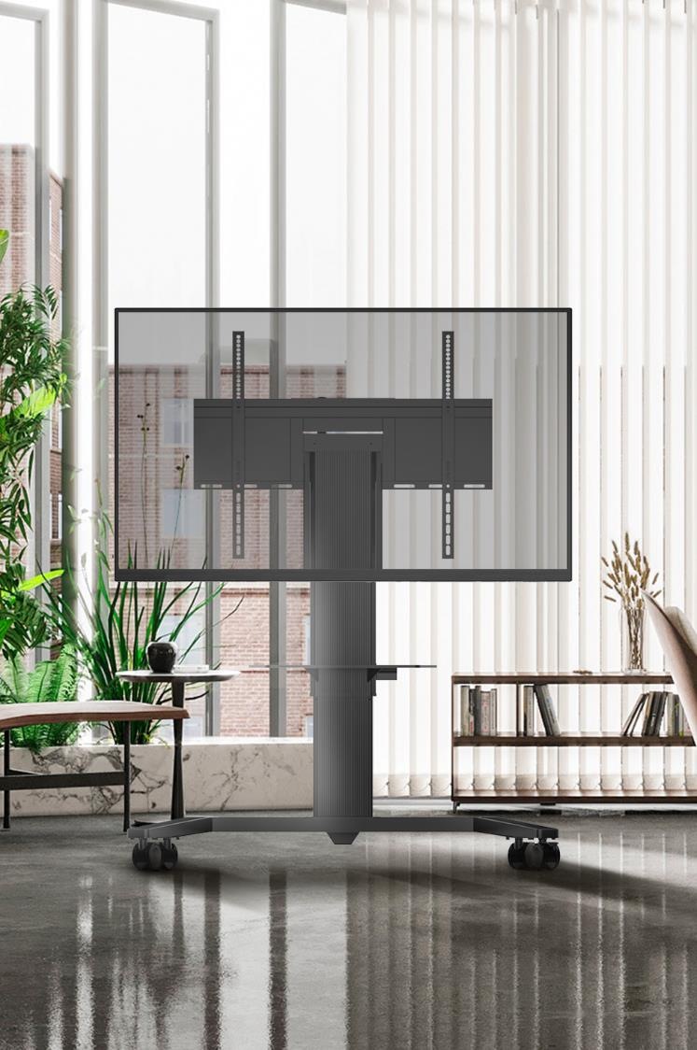

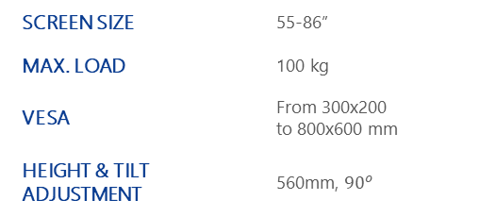
Prestigio Solutions Accessories
Mobile cart
PMBST01
Wall mount / Stand mount
PMBWMK
Electro stand
PMBST04E
SCREEN SIZE | 55-98”
MAX. LOAD | 150 kg
HORIZONTAL VESA | From 300x200 to 800x600 mm
SCREEN SIZE | 55-98”
MAX. LOAD | 160 kg
HORIZONTAL VESA | From 300x200 to 800x600 mm
SCREEN SIZE | 55-86”
MAX. LOAD | 100 kg
VESA | From 300x200 to 800x600 mm
HEIGHT & TILT ADJUSTMENT | 560mm, ${90}^{o}$
New brand in ASBIS distribution portfolio
Full range of mounting systems for LED / LCD screens and projectors

Slide 18

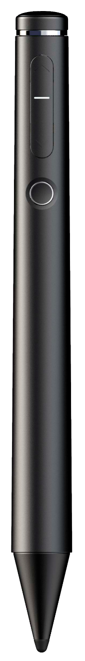
Multi Pen (in the package by default)
MULTI PEN | Specially done for writing functions, slides playback & hand writing during presentation.
OPTIONS | Easy connection Different colors writing Communication with Power Point (switching On / Switching Off, comments writing, Slide Up / Slide Down) during presentation Zooming
SIZE / MM | 187x61x21
NET / G | 27g
PRICE | FREE with Prestigio Solutions Multiboard Prime
* Applicable for all Prestigio Solutions Multiboard models, except Multiboard Light Series

Slide 19
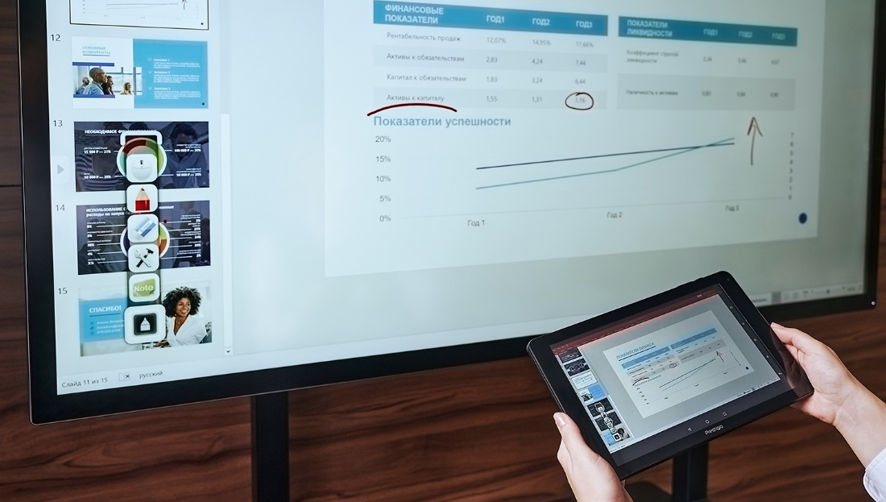
MULTIBOARD SOFTWARE

Slide 20



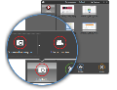




Multiboard Prime Series Software Opportunities
Apps Features
APP #1 – Connect
(license is included & FREE with Multiboard)
MultiBoard remote management from a mobile device
Mobile device mirroring
Live Camera streaming
Multimedia streaming and transfer from a mobile device (-photo / -video, etc.)
App #2 – Note 3
(license is included & FREE with Multiboard)
Integrated presentation timing option and web surfing environment
Presentation notes reserving function
Desktop screenshots capturing option
Built-in drawing tool for notes and mock-ups compatible with any apps
Use pre-se drafts on math, chemistry, physics and foreign languages with modern universal tools for evident studying
App #3 – Prestigio-Addreality
( 1 month license is included)
Get your personal Digital Signage universal tool
Create your own Digital Signage network content ,manage and distribute it easily
Create your targeted ads campaign with interactive scenarios of any complexity
Get wide and wise ad campaigns reports, including deep analytics in buyer’s portrait and auditoria reach in one system
App #4 – Capture
(license is included & FREE with Multiboard)
Record sound and video on MultiBoard screen
Save your tutorials, meetings and webinars, Skype sessions
Connect the external camera to record your conversations
Use video editor with user-friendly options
App #5 – OfficeSuite
(basic functionality FREE with Multiboard)
Create and edit any type of office documents and attachments.
Synchronize between devices with different OS
Convert PDF to Word, Excel, or ePub
Scan your physical documents to PDF via your devices' camera
Markup with digital signatures
App #6 – EasiSign
(license is included & FREE with Multiboard)
Create your own company’s anniversary, birthday greeting cards –
Share your holiday and try handwritten text messages recognition
Make a funny selfie with External video camera support option
App #7 – EasiShow
(license is included & FREE with Multiboard)
- Make your own non-standard presentations possibility of two hands mediazooming, rotating and relocating
App #8 – mClass
( 6 licenses are included & FREE with Multiboard)
Set up your business trainings and tutorials; Unite some groups via wireless technology; Stream your MultiBoard screen to notebooks, tablet PCs and mobile phones of your attendants to any operating systems
* Applicable for all Prestigio Solutions Multiboard models, except Multiboard Light Series

Slide 21
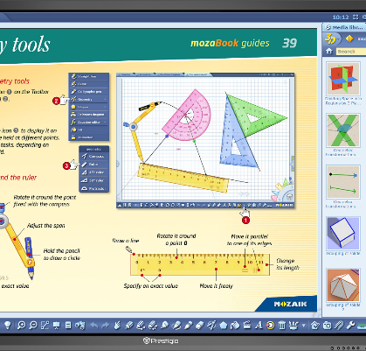

Mozabook: Whole School Library
in Prestigio Solutions Multiboard
DIGITAL COPYRIGHTED LIBRARY
Use articles, images, 3D views, apps and other materials from mozaBook to create interactive lessons on Math, Geography, Chemistry, Physics, Biology, History, Languages and many other disciplines.
OPEN FOR DIFFERENT SOURCES
Combine different materials and sources to create an unforgettable interactive lesson. If mozaBook library is not enough upload your PDF textbook, pictures and videos.
SHOW, INTERACT, PLAY
Simple mozaBook features allow you to present with visuals, write in digital notebooks and explain with dedicated games.
Opening the digital content inserted into the books;
Opening 3D scenes in the media library;
Opening videos in the media library;
Opening tools and games;
Teachers can create dynamic presentations for any school subject on the interactive board and use amazing interactive tools, 3Ds, videos and other content. They can create exercises and assignments for students.
DESCRIPTION | One year subscription. Dedicated educational software for interactivity, recommended for Prestigio MultiBoards. School library of publications, images, 3D views, games and tools. One license works on one Prestigio Multiboard.
FULL LICENSE | FULL 1 Year usage license of Mozabook Classroom for FREE with Prestigio Multiboard (with Windows PC only)
RELATIONSHIPS | Prestigio is an Official OEM partner of Mozaik Education.
Watch mozabook video
* Applicable for all Prestigio Solutions Multiboard models & PC Windows (PMB528K001 & PMB528K002), except Multiboard Light Series

Slide 22

SPECIAL OFFERS

Slide 23

PMB728L753| 75” (Prime Series)
SPECIAL OFFER VALID TILL THE END OF MARCH 2023 ONLY
DISPLAY | 75‘’ (UHD) / 3840×2160 / 3mm tempered glass IR touch 10 points writing, 20 points touch
OS | Windows 10 Pro (official license injected)
RESPONSE TIME | 8 ms
BRIGHTNESS / CONTRAST | 390 cd/m2 (orig LCD) / 3100:1
REFRESHING FREQUENCY | 60Hz
LIFETIME | 30 000 hours
DISPLAY INTERFACES | HDMI IN x 3; USB 2.0 x 1; USB 3.0 x 4 (incl 2 in front); USB Type C x 1; Touch Port x 2; VGA IN x 1; AUDIO IN x 1; AUDIO OUT x 1; RS232 x 1; RJ45 IN x 1; RJ45 OUT x 1; Integrated Light Sensor
WINDOWS PC | Intel® Core™ i7 (10th gen CPU 10700, 2.9GHz) / 8GB DDR4 / 256GB SSD
GRAPHIC CARD | Independent Graphic Card GTX1050Ti
ONBOARD | 16W x 2
PC INTERFACES | USB 3.1 x 1; USB 3.0 x 4; USB 2.0 x 2; MIC x 1; RJ45 x 1; HDMI OUT x 1; DP OUT x 1; WiFi (2.4 & 5 GHz); Kensington Lock x 1; AUDIO OUT x 1;
EXTRA PC TYPE / OS | Android 9.0 (limited)
EXTRA PC SPECS | CPU ARM Cortex A73 x 4 / RAM 4GB / ROM 32GB
OVERALL/STANDBY POWER CONSUMPTION | 550W / ≤0.5W
DIMENSIONS / D. (PACK) L*H*W, MM | 1709*1019.5*85.7 / 1860*280*1140 mm Metal Back cover
NET / SHIPPING WEIGHT, KG | est. 49.5 / 63.9
PREINSTALLED SOFTWARE | Apps for education, conference and meetings
IN THE BOX | QSG, AC power cable, remote control, 6 Writing Pens (incl 2 Pens for writing double colors in parallel) & One Multi Pen, USB Touch/HDMI cables, USB-driver stick, Warranty Card
RDP / RRP | $2999 / $3999 USD w/o VAT
*Applicable for local stock as well.
Should be prior approved with Prestigio Solutions HQ

Slide 24
Your reliable partner
in solutions for business and education
Thank you!

